Slide 1

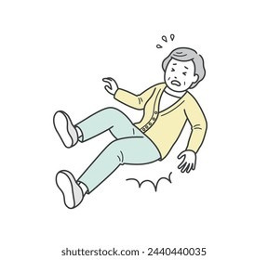
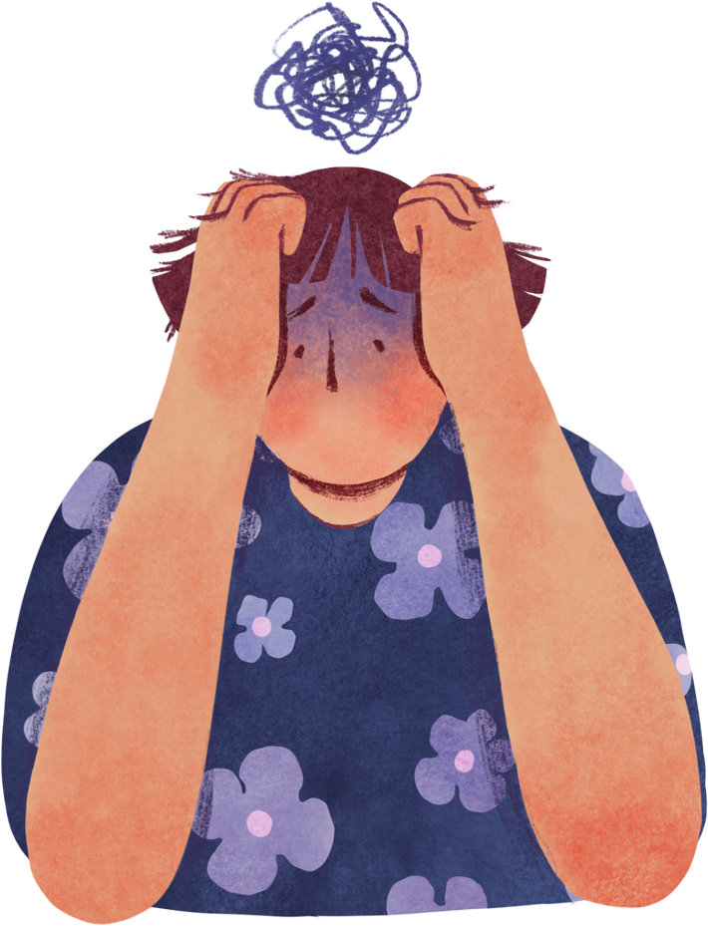


Guardian Sense
Awareness
Is she Goona Be fine?
Why was I so Careless
The Bill Is too Costly
By Team Error 505

Slide 2
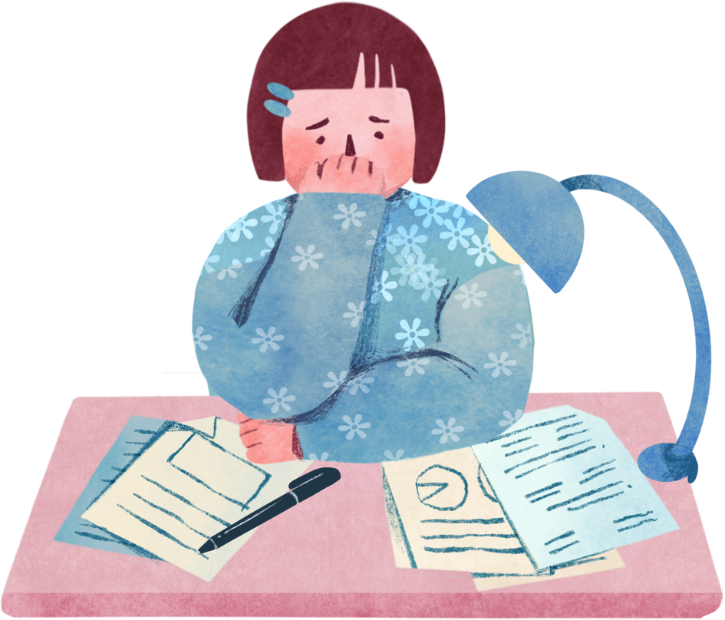
What is the problem?
Will My grandma be Okay?
Early detection + verification (so false alarms are filtered) means faster help, less time lying alone after a fall — which can reduce complications (hypothermia, dehydration, further injuries).
Falls are one of the leading causes of injury and emergency hospitalization among the elderly, patients with mobility issues, and individuals living alone.
The delay in detecting a fall and notifying caregivers often leads to severe health complications or even fatalities. Existing solutions are either too expensive, lack real-time alerts, or are not easily scalable for home and institutional use.
Fall-related injuries are expensive: hospital visits, emergency care, surgeries (especially hip fractures or head injuries)

Slide 3
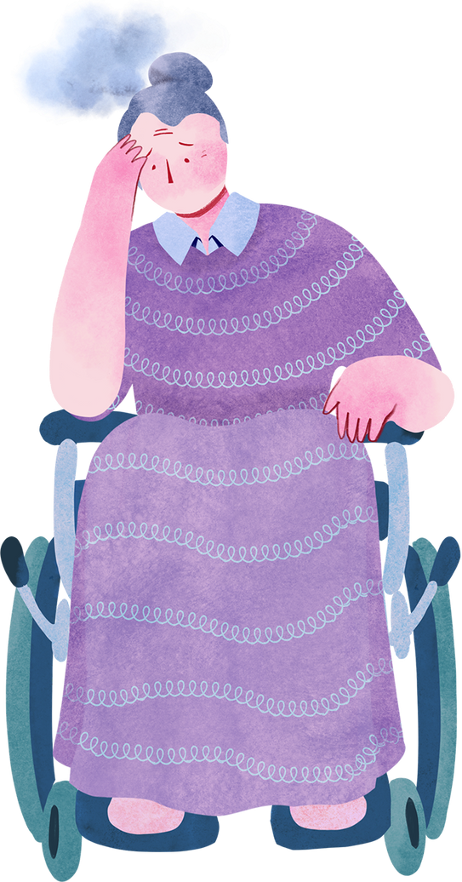


About 71.6% of falls that require emergency room treatment happen indoors, and of those, ~79.2% are at home.
In the U.S., more than 14 million older adults (65+) report falling every year. CDC+1
Around 1 in 4 older adults fall each year
Falls are the second leading cause of unintentional injury deaths worldwide. World Health Organization
Each year there are about 37.3 million falls globally that require medical attention.
Why It’s Important
Even when falls don’t cause major injury, they often restrict activities afterward, either because of pain, fear of falling again, or because mobility is reduced.
Most falls happen indoors at home exactly where Guardian Sense would operate. So the device is addressing the prime location of risk.

Slide 4

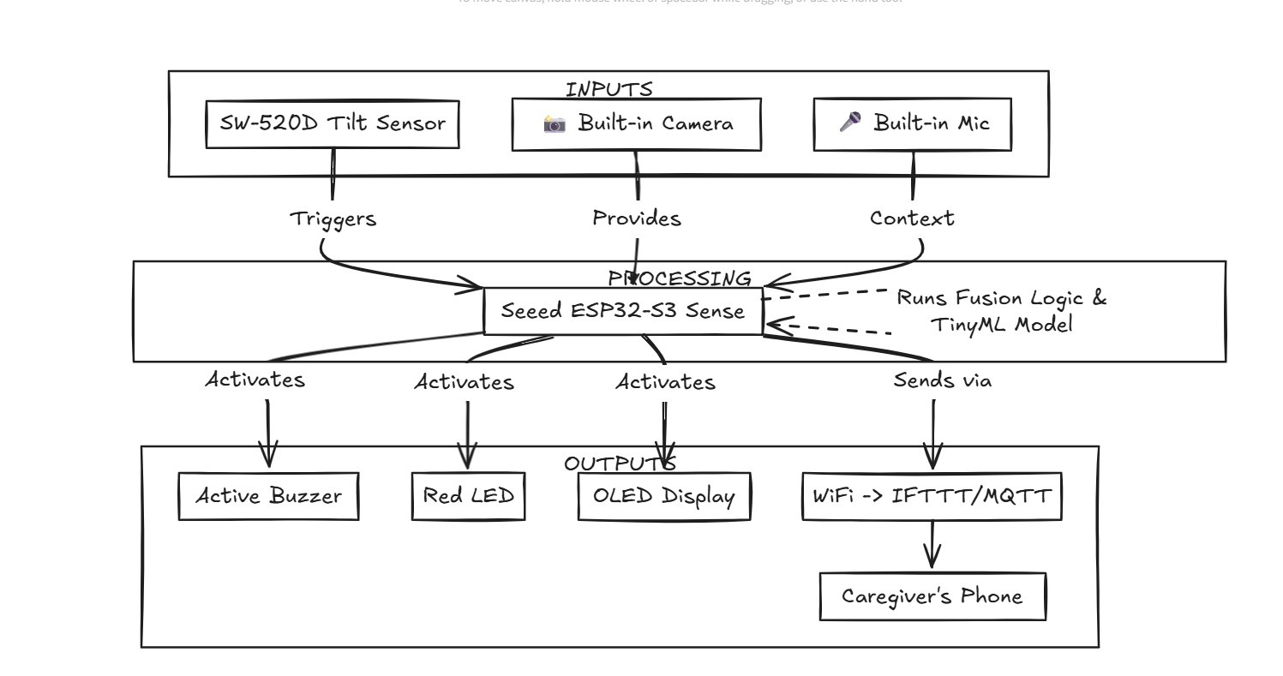
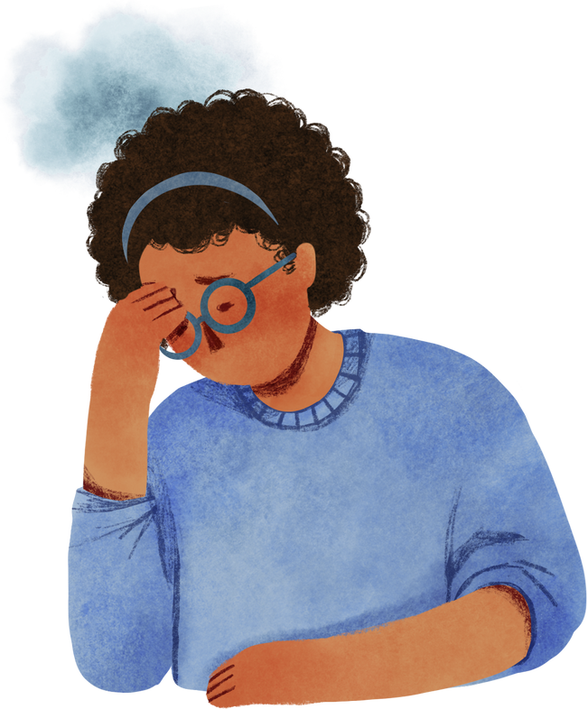
Because every elder deserves a safer tomorrow.
How it Works

Slide 5
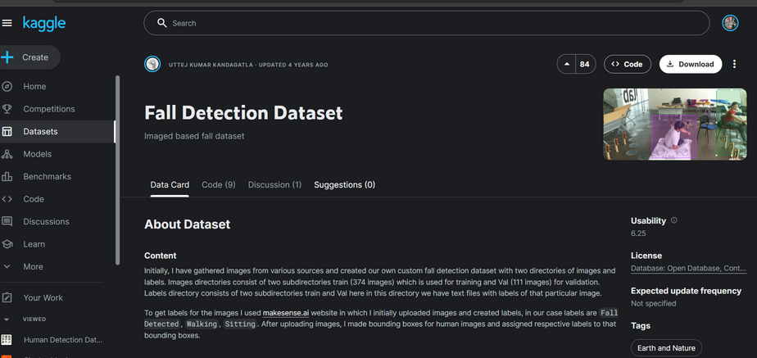

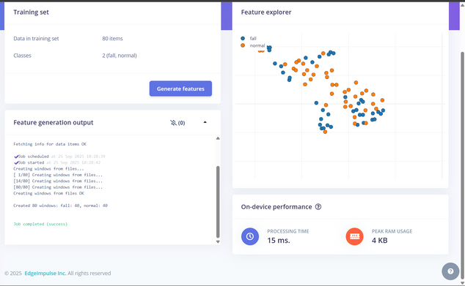
Tech StacK
Kaggle Dataset
Fact
Hardware
Xiao ESP32-S3 Sense, RGB LED, LCD1602, sensor.
Communication
Telegram Bot API.
Classification of Our ML model In Edge Impulse

Slide 6
Smart Fall Detection Devices
Business Model / Use Case
Valued at ~ USD 1.25B–1.41B in 2024; expected to reach USD 4.18B by 2034. CAGR ~ 12–13%.
Target People
Target Audience: Elderly care homes, individual households, hospitals, caregivers.
Elderly Living Alone
Seniors who are independent but at high risk of falls.
Care Homes & Nursing Facilities
Institutions with many elderly residents.
Hospitals & Rehabilitation Centers
Patients recovering from surgery, stroke, or mobility issues.
Disabled / Mobility-Impaired Individuals
People with physical disabilities or chronic conditions.
Families & Caregivers
Immediate notification via Telegram ensures faster action.
Monetization:
Affordable hardware kit (~$20–30) for households.
Subscription for advanced caregiver dashboard & analytics
Scalability: Easily deployable in households, nursing homes, or hospitals.
Real-World Impact: Saves lives by reducing emergency response time and providing peace of mind for families.

Slide 7
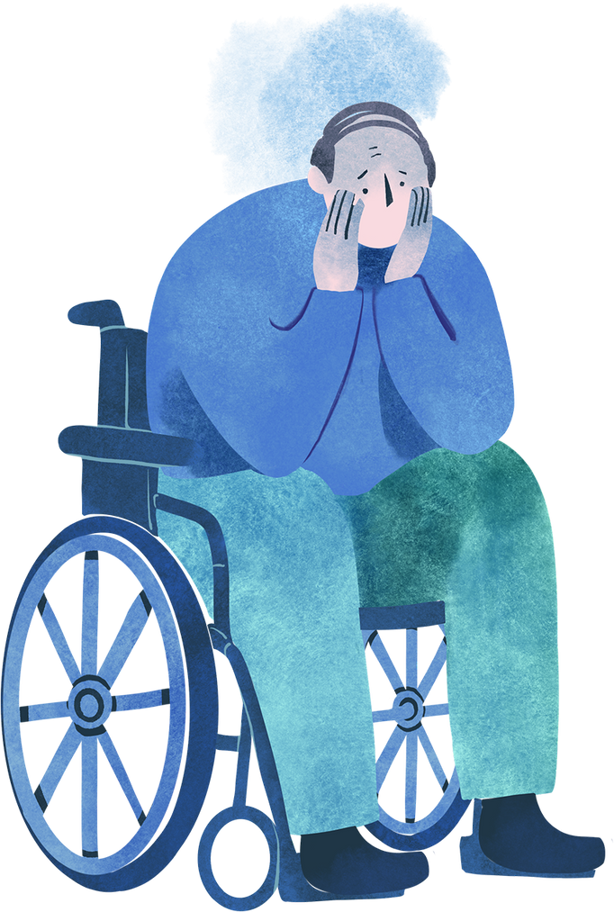
Proposed Solution
With A two Step Verifiaction
Guardian Sense:
A fall-detection and emergency alert system that instantly notifies caregivers via Telegram and visual indicators.
Key Features & Functionality:
Real-time fall detection using Xiao ESP32-S3 Sense (IMU + sensors).
Immediate Telegram bot notification to guardians/caregivers.
Local alert via RGB light (ambulance-style flashing).
LCD status display for transparency and easy monitoring.
Using Custom ML model to verify the Model
Problem Solved:
Provides timely alerts for elderly or patients in case of a fall, reducing response delay and preventing serious injury risks.
“Every fall avoided is a life preserved — because in old age, every moment of safety is a gift of dignity.”

Slide 8


Globally, 1 in 3 adults over 65 experiences a fall each year.
That’s ~684 million elderly people at risk annually (WHO, UN data).
In India alone, >25 million elderly face fall-related injuries every year.
Conclusion & Future Scope
👉 Our mission: To change the lives of millions of seniors and caregivers by making safety affordable, accessible, and real-time.
With Guardian Sense, even preventing 1 in 10 falls could safeguard tens of millions of lives worldwide, reducing hospitalizations, medical costs, and emotional trauma for families.
Current Status (Hackathon Build): Working prototype with fall detection, Telegram alerts, RGB emergency flashing, and LCD status screen.
Future Improvements:
GPS integration for outdoor tracking.
AI-based motion analysis to reduce false positives.
Wearable or IoT integration with smart home systems.

Slide 9
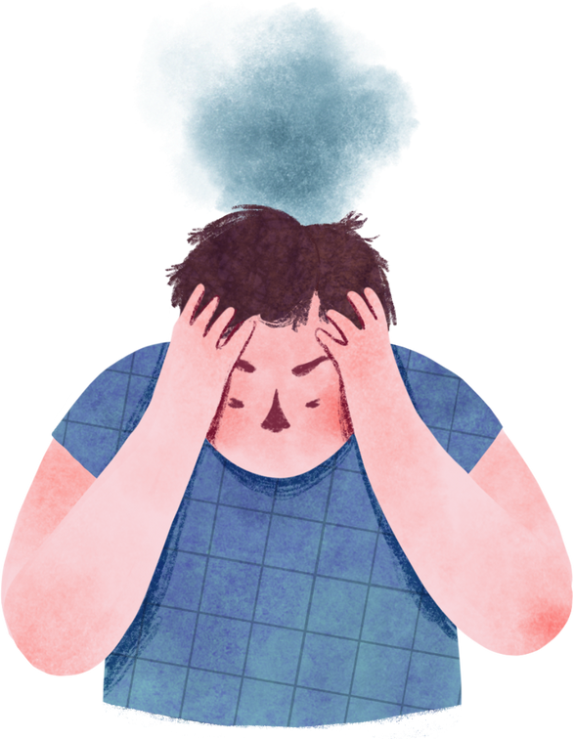
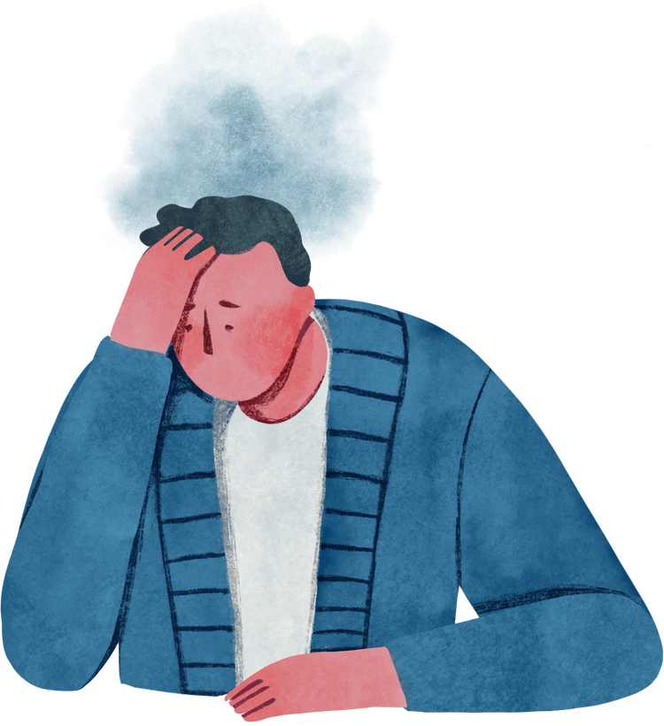
Your tension ends here Guardian Sense watches over your loved ones.
Safety you can trust, care they can feel
Your peace of mind, your elders’ safety in our hands
Buy now
https://dearabhin.github.io/Guardian-Sense/

